Slide 1

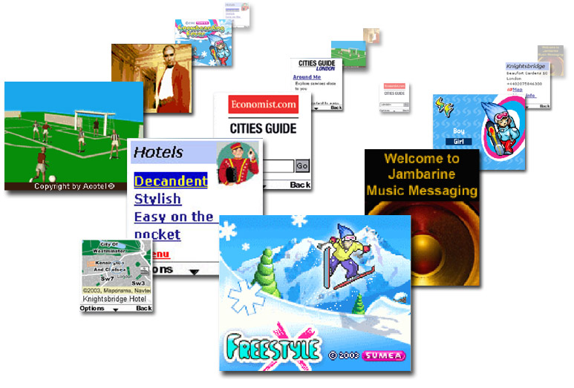

Innovations, Applications & Services
Cemal Yurteri
Senior Solution Manager
Nokia Singapore
4th December 2004
Bangkok

Slide 2

CONTENT
Evolving Mobile Services
Role of SIP and IP Multimedia in the Next Generation Services
SIP Service Examples
Live Application Use Case Demonstration
Conclusion

Slide 3
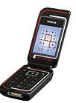

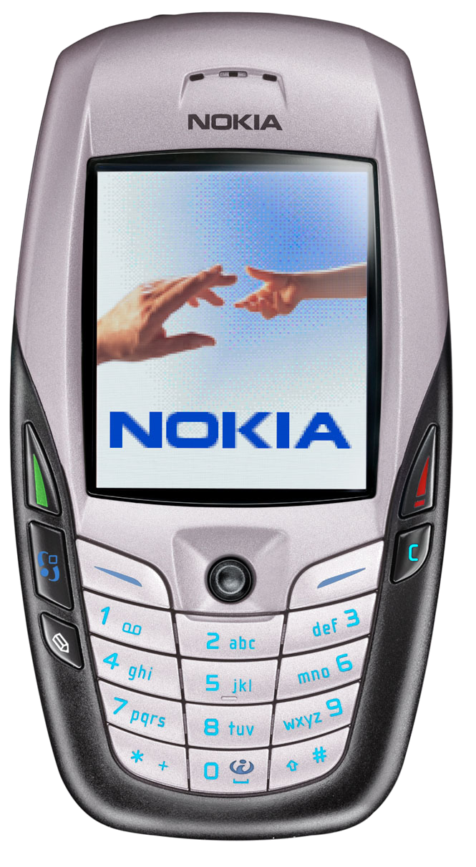

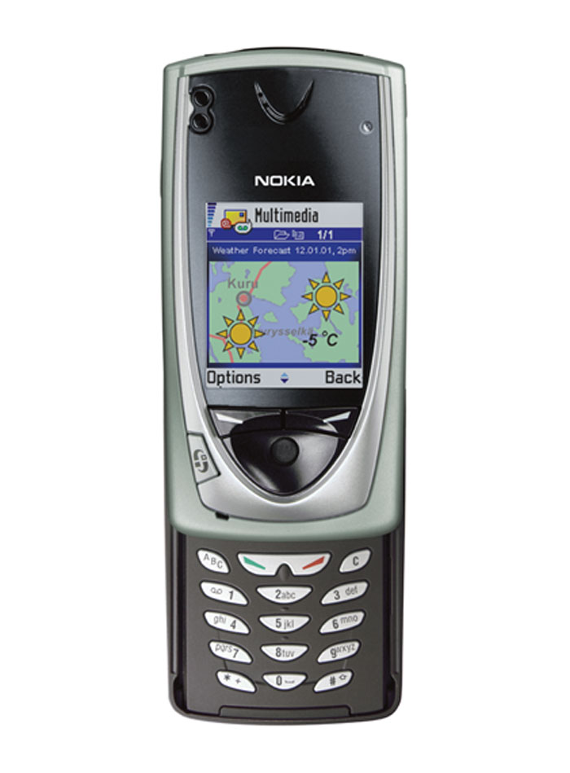
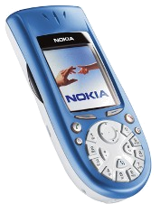


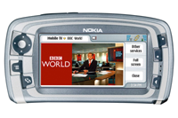

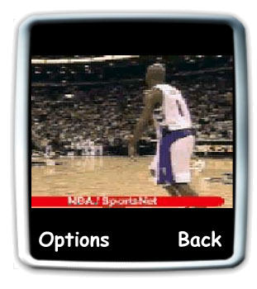
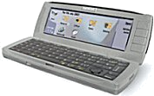

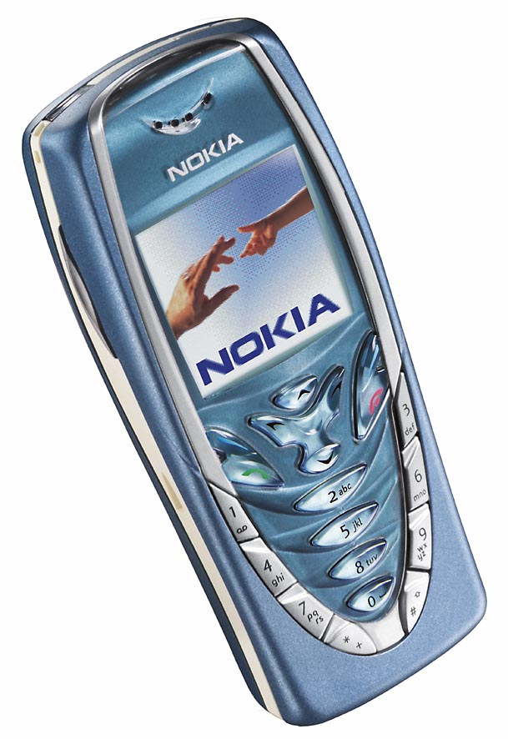
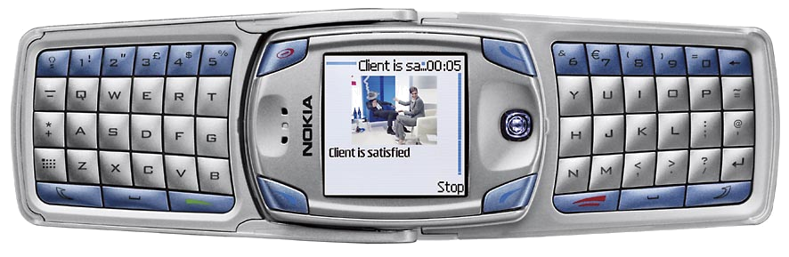

Evolving mobile services
Sharing moments and
communicating effectively
with media of your choice
Person-to-person
services
Video sharing
Push-to-talk
The favorite, personalized channel to rich infotainment and Internet services
video messaging
photo and audio messaging
Seamless
mobile office
Content-to-person
services
Full Internet
browsing experience,
high-value videos
Enhanced
browsing,
versatile
applications
Short
videos
Basic
applications
Multiaccess
services
Basic browsing,
rich terminal
personalization
Improved performance
and usability for SMEs
Business
services
Secure corporate connectivity

Slide 4

Good Old Success Stories
Face-to-face communication
Old communication technology
  Drumming
  Smoke signals
  Letters
Modern communication technology
  Voice calls
  SMS
  MMS
Common element: person-to-person communication

Slide 5


…and the New Ones
ByTheWay today 66%-90% of
Internet traffic is
peer-to-peer
depending on the source
Rich
messaging
Messaging
Real time
video
sharing
Presence
Push to
talk
Content
sharing
Chat
Voice
Interactive
gaming
PERSON-TO-PERSON
COMMUNICATION WITH RICH MEDIA
AND CONTENT
We believe that new richer services will fulfill
people’s natural needs to communicate with each other

Slide 6


IP Multimedia & SIP!
What are the next services to target?

Slide 7

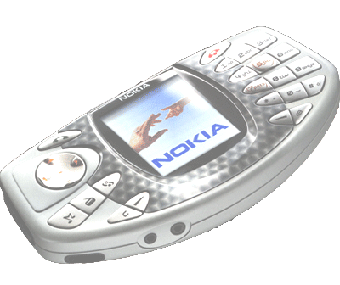
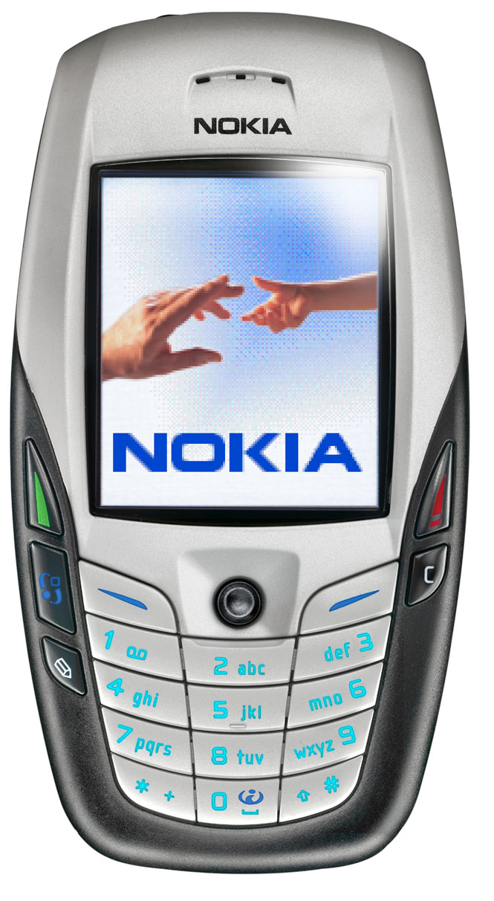
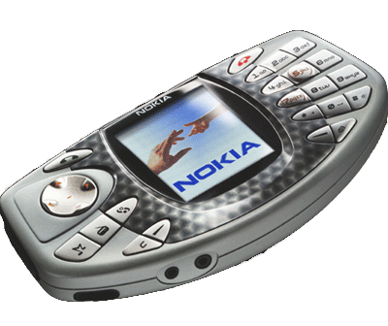
Evolving Services need Evolving Service Enablers
What we can offer in an IP-based world
is something different:
SIP
SIP
SIP
SIP
a direct channel between two terminals
or a group of terminals…
…and applications running in the terminals

Slide 8
What is SIP…
SIP
Session Initation Protocol:
    Defined by the Internet Engineering Task Force (IETF);
    Designed after HTTP.
SIP is used for initiation of interactive communications sessions between users. SIP also handles termination and modifications of sessions;
Although originally designed for multimedia sessions:
    Scope has been extended: presence, gaming, instant messaging, etc.;
    SIMPLE: SIP for Instant Messaging and Presence Leveraging Extensions.
Smarter than your ”usual transport”:
    Personal addressing, routing, etc.
Since its approval in early 1999 as an official standard, SIP has gained wide market acceptance for communications signalling on the Internet;
More information from IETF RFC-3261.

Slide 9

SIP Covers 5 Aspects of Multimedia Communication
Where are you?
User
Location
Can I call you?
What can you do?
User
Availability
User
Capabilities
SIP
Session
Setup
Session
Management
Change the call
Establish/Tear down a call

Slide 10

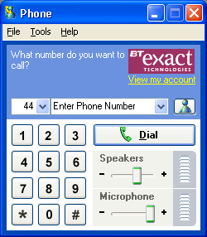
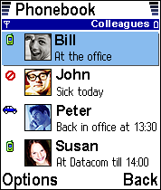
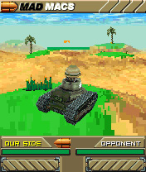
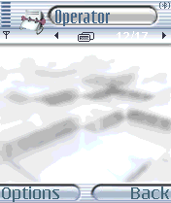

Services Enabled with SIP
Voice over IP
Presence
Instant messaging
Gaming
Content Sharing
Rich call
Conference call
Event notification
User Profiling
Chat
White boarding, bloging
Video on Demand
Interactive-TV
  .
  .
  .
Combination of services
Voice
Presence
Game
Free tee times for today from 16:40 on
Messaging

Slide 11
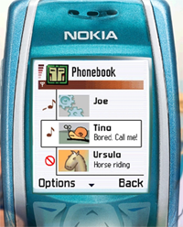
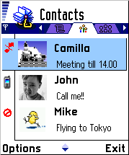


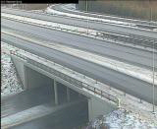
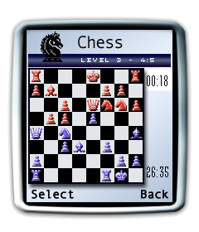
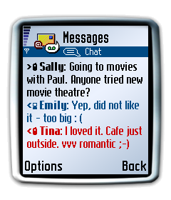
Presence tells you when and how to communicate
I am in the mood now..
’Check first how to communicate’
Presence supports self-expression
Champions League
latest news
Valtatie 3 Hämeenlinna
10:19: 1,2 °C, wet, clear
Traffic updates
+ 34 609 4444444
Presence can also be used for advertising and information sharing
Presence enables and enriches other services

Slide 12












You see, I am so sad now!
Presence can be used for practical, emotional things and most of all it is also FUN part of communication!

Slide 13
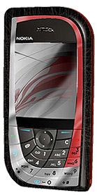
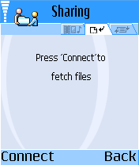
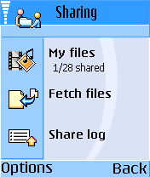
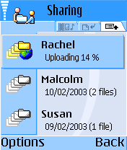
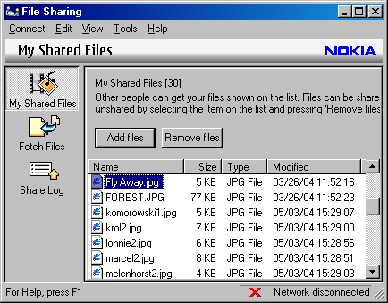
Content sharing
First, direct file sharing between terminals
Can be used to transfer files between users or later
between group of users
Sharing also between PC & Mobile
PC Client

Slide 14


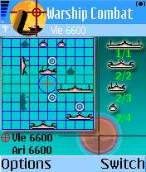
Multiplayer Gaming in the Network
IP Multimedia Core finds the other terminal and connects the terminals with IP
Find and connect
SIP Stack and Multiplayer Gaming application
Operators
IP Multimedia
Netwok
SIP
SIP
Operator’s Packet-switched network
(GPRS)
UDP/TCP
IP connection over
Mobile Network
Gaming data directly between terminals!

Slide 15
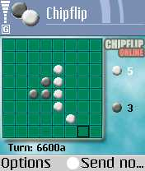
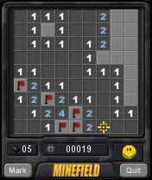

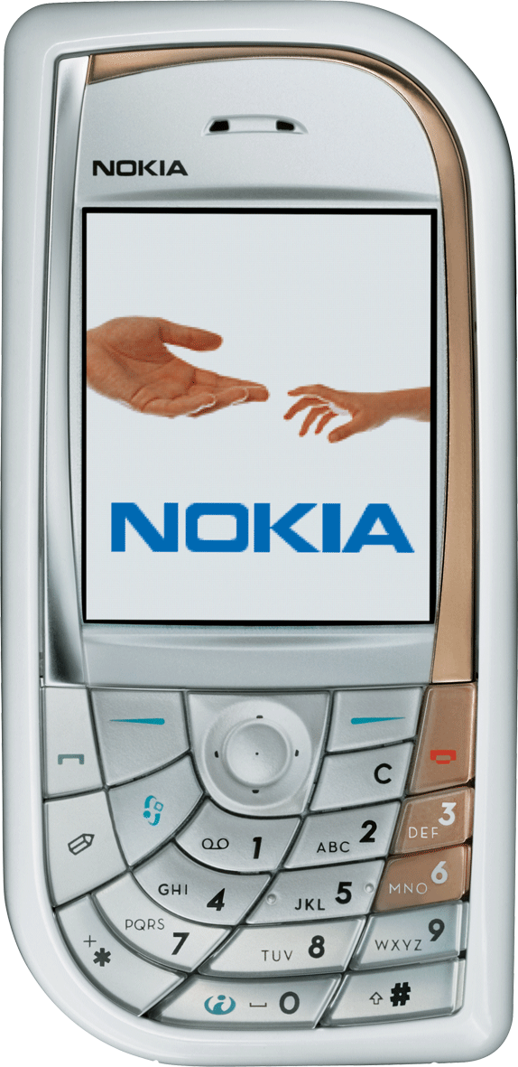
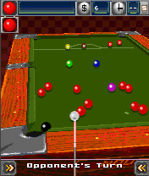

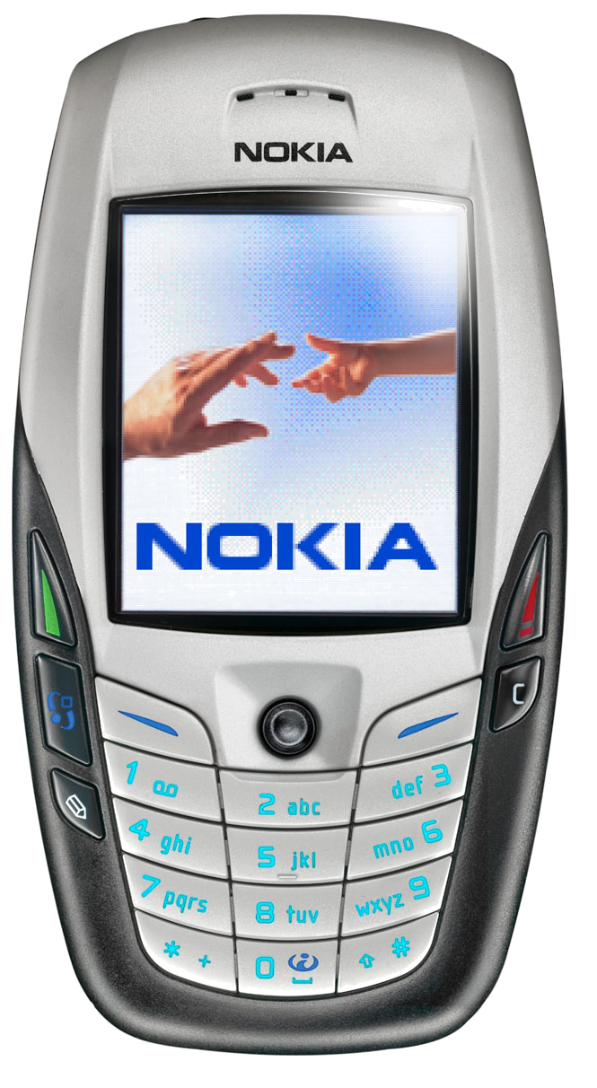


Interactive Multiplayer Games – How ?
Game Server
Download
Operators
IP Multimedia
Netwok
Invite
&
Connect with IMS
… and play!

Slide 16
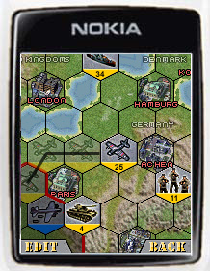

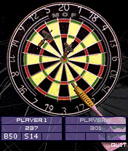
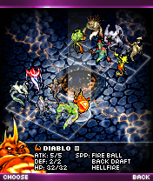

Some 3rd Party Game screen shots
Mad Macs
Mobile VR Pool
Darts
Massive Multipart Games

Slide 17
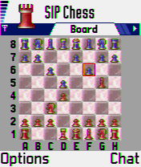



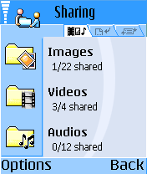


Typical Use Case of IP Multimedia
Real Time Video
VoIP
Push2Talk
Content
sharing
Interactive applications
Multimedia
communication
… all these with a single session control mechanism
for better usability = IP Multimedia Subsystem

Slide 18

How & when ?
Mobile IP Multimedia is happening now and applications can be developed for Nokia Terminals
What is available for you?
        Series 60 SIP Software Development Kit
        Installation program
        User Guide
        Release Notes
        Example SIP Application
        SIP Stack SIS file
        Documentation:
        White Paper & Updated FAQ
      SIP Plug in is available via www.forum.nokia.com
Start SIP development today with the Nokia SIP Plug-in and develop your application for special Nokia DTAC iAwards!

Slide 19
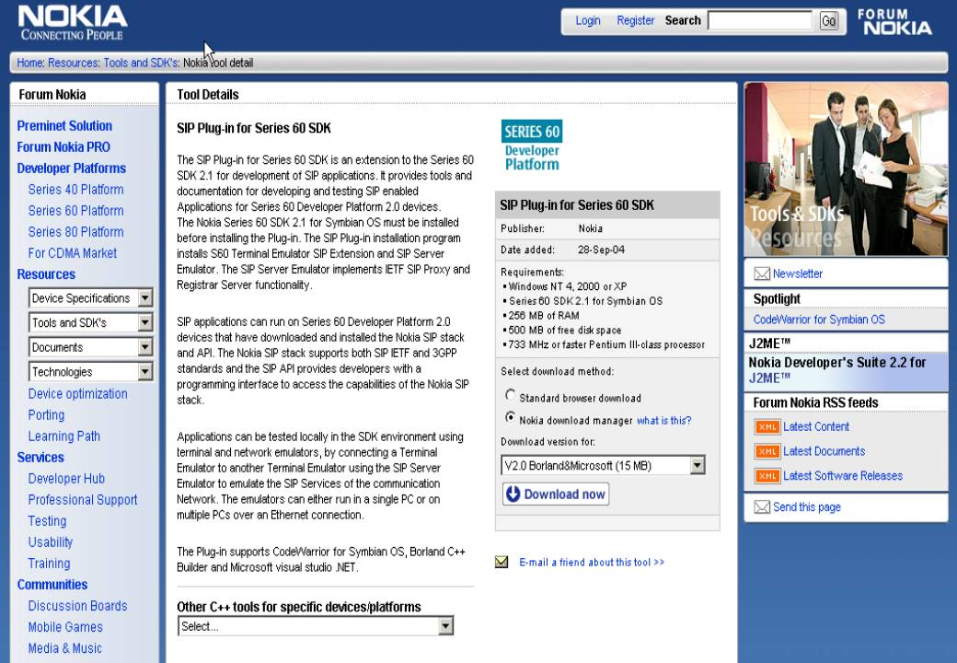
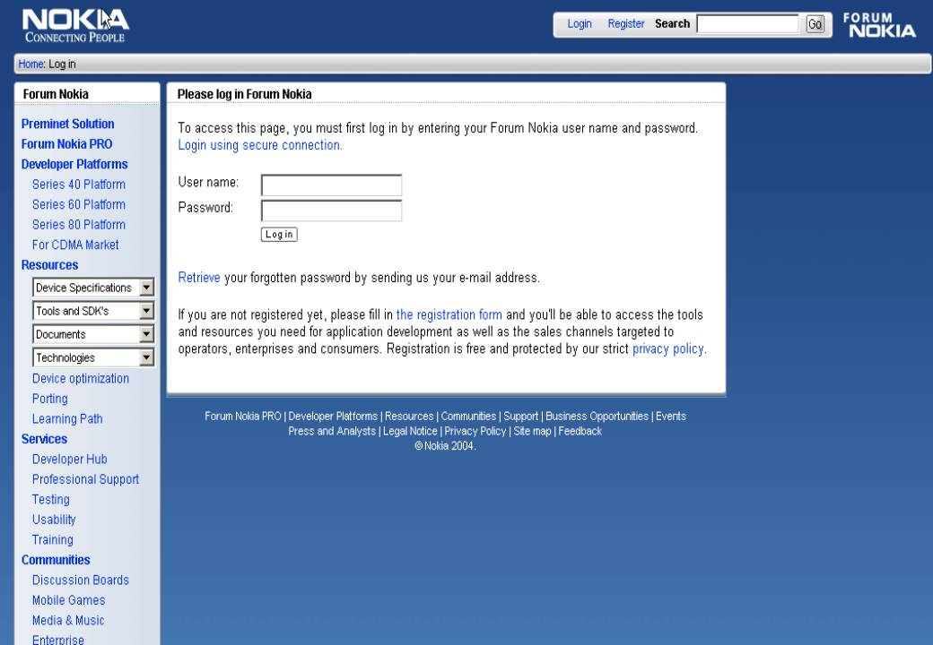
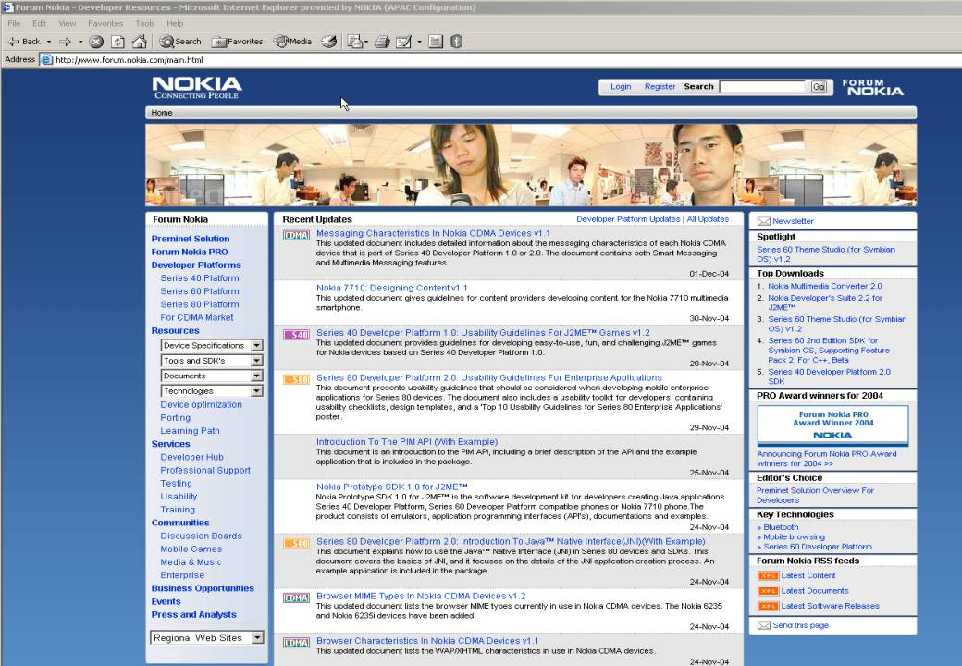

Slide 20

Kop Khun
Krap!
Innovations, Applications & Services
will continue…
IP Multimedia and SIP enabled services will be inevitable!

